Slide 1
Python Introduction and Facts

Slide 2
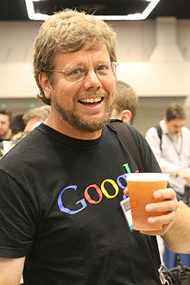
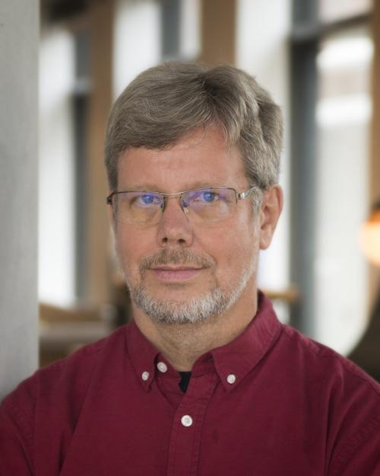
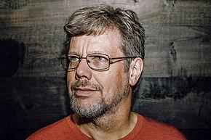
Meet Creator of Python: Guido van Rossum

Slide 3
What is Python?
Python is an interpreted, Multi Purpose, object-oriented programming language similar to PERL
Python is said to be relatively easy to learn.
Python 1.0 was released in 1994.

Slide 4
Python documentation and help
Documentation
https://docs.python.org/3/
Take Help
https://www.python.org/about/help/

Slide 5
Python documentation and help
help() # Starts an interactive help
help("topics") # Outputs the list of help topics
help("OPERATORS") # Shows help on the topic of operators
dir([]) # Outputs a list of attributes of a list, which includes functions
import re
help(re) # Shows help on the help module

Slide 6
Thanks

